Slide 1
Civil Rights & Redress (1877-2000)
Japanese American Redress Movement vs. Disability Rights Movement

Slide 2
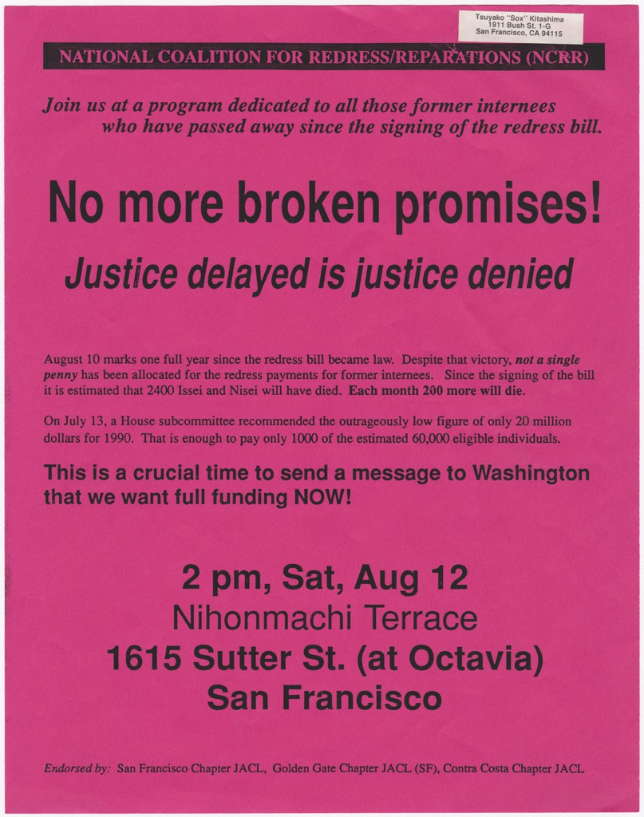
Movement 1: Japanese American Redress
Injustice - Redress for WWII incarceration
Timeline
  1942- 45: Incarceration during WWII
  1980: Commission created (CWRIC)
  1982: Personal Justice Denied (report)
  1988: Civil Liberties Act - apology and payments
Goal: Official acknowledgment and reparations for a specific past injustice.
Primary source (Poster)
  Created by the National Coalition for Redress and Reparations (1990s)
  Used to inform and mobilize the public about the redress bill
  Emphasizes that justice delayed is justice denied
  Shows grassroots organizing, not court action
  Helped build public pressure on Congress
  Supports demand for apology and reparations for WWII incarceration
Result: Civil Liberties Act (1988) - formal apology and reparations
Poster informing the public about a program regarding the redress bill

Slide 3
Movement 1 strategies: how redress was won
1) Build an official record
Commission hearings and testimony
2) Pressure Congress
Lobbying and coalition-building
3) Public education
Community materials and programs
Federal report labels incarceration as injustice
Use "redress" framing to win votes
Keep the issue visible over time
Outcome: A federal law (1988) provided an apology and monetary reparations.

Slide 4
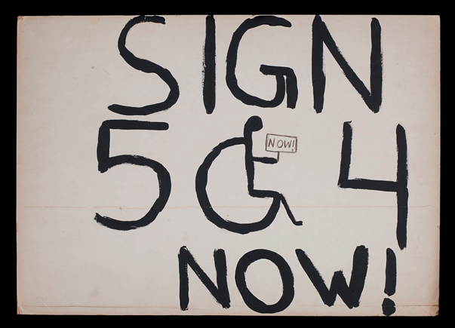
Movement 2: Disability Rights
Timeline
  1973: Rehabilitation Act (Section 504)
  1977: 504 sit-ins demand enforcement
  1990: Americans with Disabilities Act (ADA)
Primary source
  Created by disability rights activists during the 1977 Section 504 sit-ins
  Used to demand immediate enforcement of existing law
  Shows direct action and protest as a key strategy
  Emphasizes urgency: rights delayed are rights denied
  Reflects frustration with government inaction
  Helped push enforcement of Section 504 and later the ADA
Poster: “Sign 504 Now”

Slide 5
Movement 2 strategies: how rights were enforced
Common tactics
  Protests and sit-ins to force government action (504)
  Coalitions across disability groups and allies
  Push for broad civil rights law (ADA)
  Ongoing enforcement and implementation battles
What makes this different from Japanese American redress?
  Disability rights aimed at changing rules for the future (access and equality),
  not mainly paying compensation for one past event.
Outcome: Rights expanded through law and enforcement (504 - ADA).

Slide 6
Compare & contrast
Category | Japanese American Redress | Disability Rights
Injustice | WWII incarceration (state action) | Ongoing discrimination and barriers
Main target | Congress and executive apology | Federal rules and broad civil rights law
Key tactics | Official record and lobbying and public education | Sit-ins and protest and coalitions and enforcement
Outcome | Apology and reparations (1988) | Anti-discrimination protections (1990)
Redress style | Retrospective repair | Prospective rights and access
Same goal, different routes

Slide 7
Preliminary thesis
Minority groups sought redress by pressuring the federal government to admit injustice and act, but their approaches differed based on their goals. Japanese Americans pursued retrospective repair through an official record and a reparations law, while disability rights activists used protest and policy enforcement to win broad anti-discrimination protections.
Takeaways
Redress can be “repair the past” (apology/reparations) or “protect rights going forward.”
Both movements used federal law, but got there differently.
Public storytelling and organizing mattered in both cases.

